Slide 1
Optimization (Gradient Descent & Backprop)
Deep Learning: Bryan Pardo, Northwestern University, Fall 2020

Slide 2
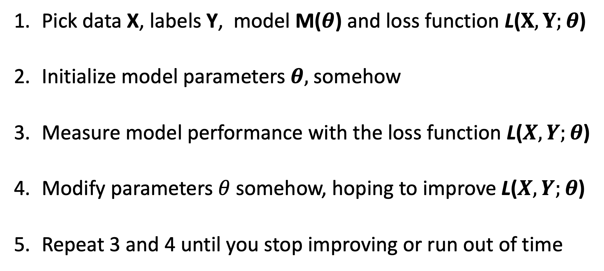
Supervised Machine Learning in one slide
Pick data X, labels Y, model M($θ$) and loss function L($X,Y;θ$)
Initialize model parameters $θ,$somehow
Measure model performance with the loss function L($X,Y;θ$)
Modify parameters $θ$somehow, hoping to improve L($X,Y;θ$)
Repeat 3 and 4 until you stop improving or run out of time
HOW?

Slide 3
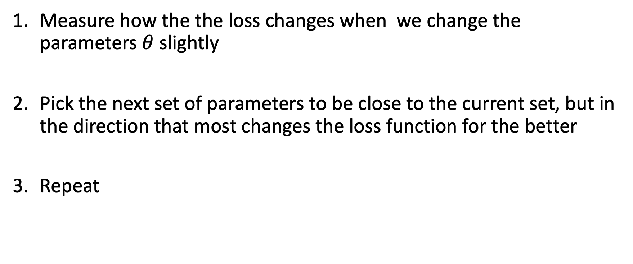
A common approach to picking the next parameters
HOW?
Measure how the the loss changes when we change the parameters $θ$slightly
Pick the next set of parameters to be close to the current set, but in the direction that most changes the loss function for the better
Repeat

Slide 4

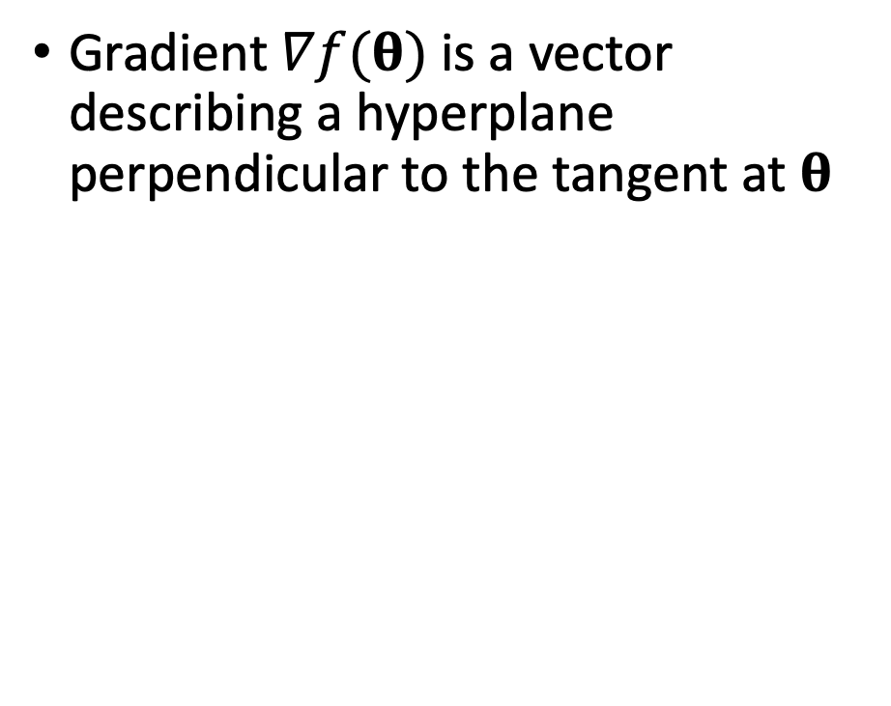
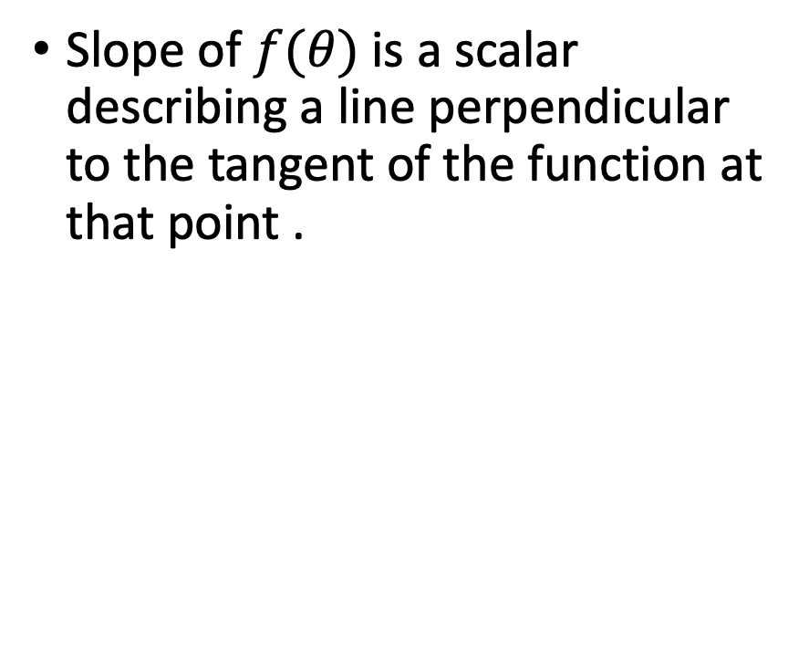
Slope vs gradient
Slope of $f(θ)$is a scalar describing a line perpendicular to the tangent of the function at that point .
Gradient $∇f(θ)$is a vector describing a hyperplane perpendicular to the tangent at $θ$

Slide 5
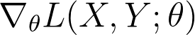
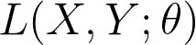
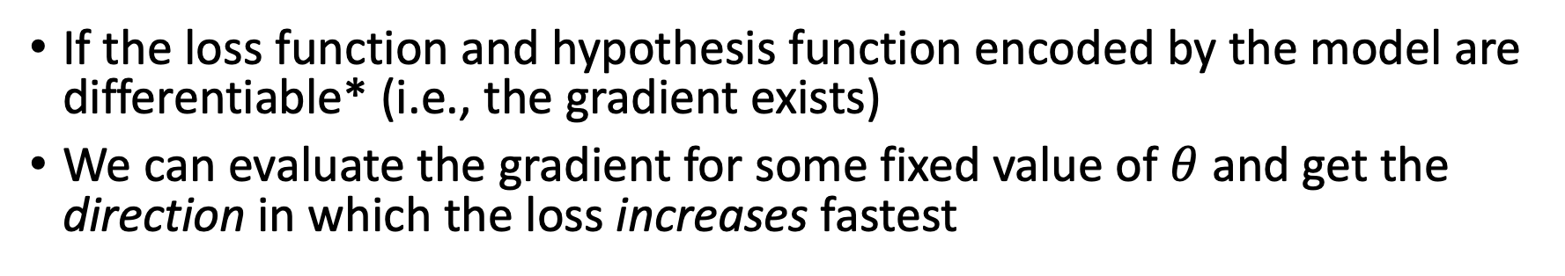
What does the gradient tell us?
If the loss function and hypothesis function encoded by the model are differentiable* (i.e., the gradient exists)
We can evaluate the gradient for some fixed value of $θ$ and get the direction in which the loss increases fastest
*or subdifferentiable
Notes:
This is a graph of the “loss landscape” for a univariate model

Slide 6
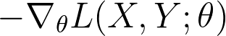
What does the gradient tell us?
We want to decrease our loss, so let’s go the other way instead
Notes:
This is a graph of the “loss landscape” for a univariate model

Slide 7
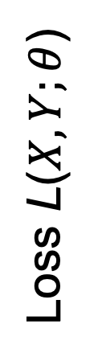
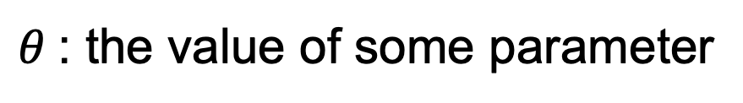
Gradient Descent: Promises & Caveats
Much faster than guessing new parameters randomly
Finds the global optimum only if the objective function is convex
Loss L($X,Y;θ$)
$θ$: the value of some parameter

Slide 8
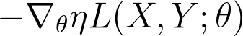
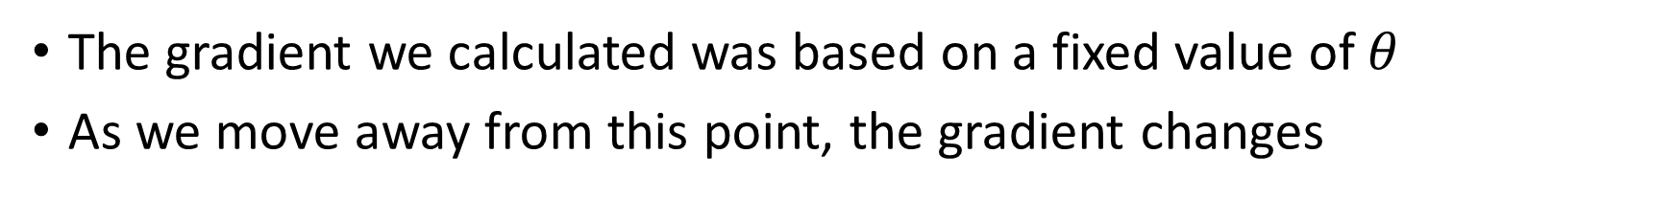
Step Size: how far should we go?
The gradient we calculated was based on a fixed value of $θ$
As we move away from this point, the gradient changes
If the step size is too large, we may overshoot the minimum
If the step size is too small, we need to take more steps (more computation)
Notes:
Remind students of the similarity with adaptive epsilon updates in reinforcement learning

Slide 9
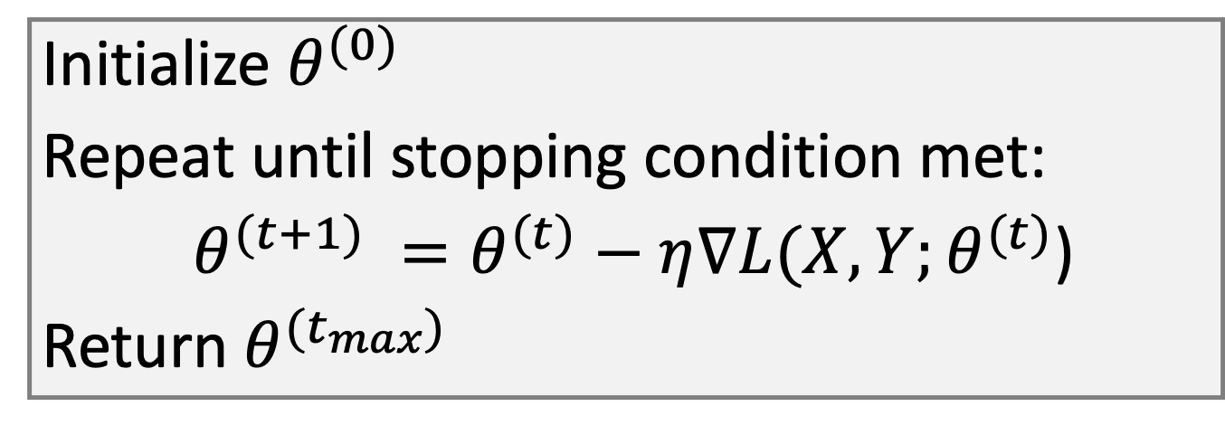
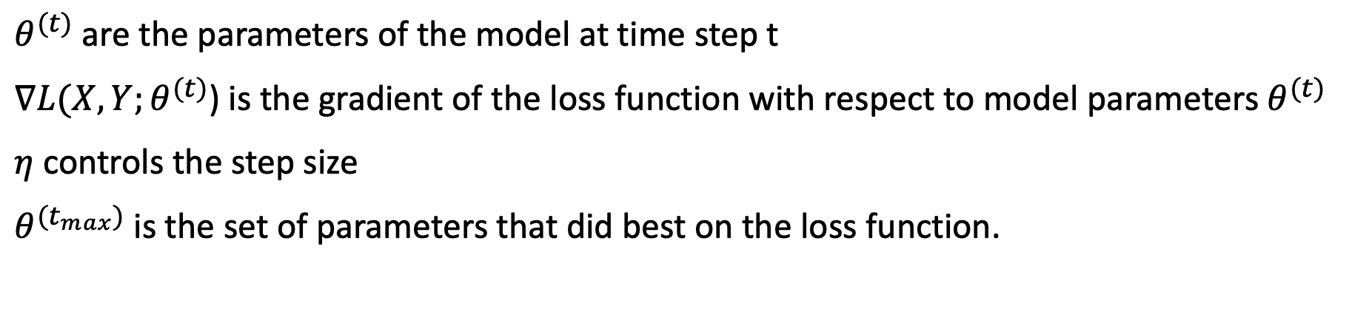
Gradient Descent Pseudocode
Initialize $θ^{(0)}$
Repeat until stopping condition met:
$θ^{(t+1)} =θ^{(t)}−η∇L(X,Y;θ^{(t)}$)
Return $θ^{(t_{max})}$
$θ^{(t)}$ are the parameters of the model at time step t
$∇L(X,Y;θ^{(t)}$) is the gradient of the loss function with respect to model parameters $θ^{(t)}$
$η$ controls the step size
$θ^{(t_{max})}$ is the set of parameters that did best on the loss function.
Notes:
Remind students of the similarity with adaptive epsilon updates in reinforcement learning

Slide 10

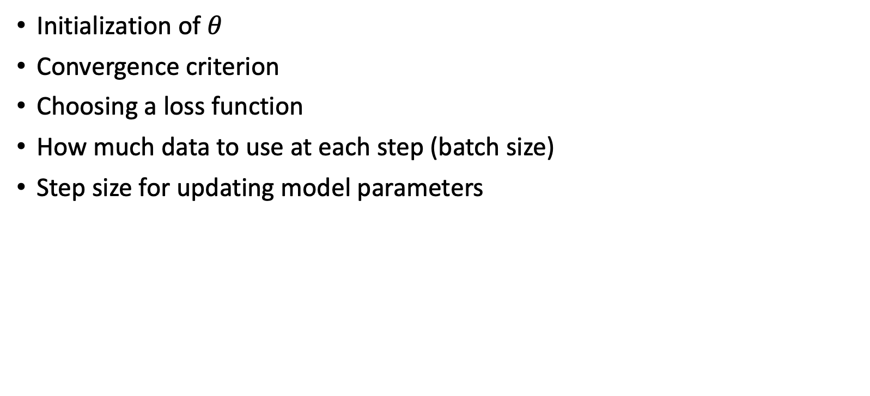
Design choices
Initialize $θ^{(0)}$
Repeat until stopping condition met:
$θ^{(t+1)} =θ^{(t)}−η∇L(X,Y,θ^{(t)}$)
Return $θ^{(t_{max})}$
Initialization of $θ$
Convergence criterion
Choosing a loss function
How much data to use at each step (batch size)
Step size for updating model parameters
Notes:
Remind students of the similarity with adaptive epsilon updates in reinforcement learning

Slide 11
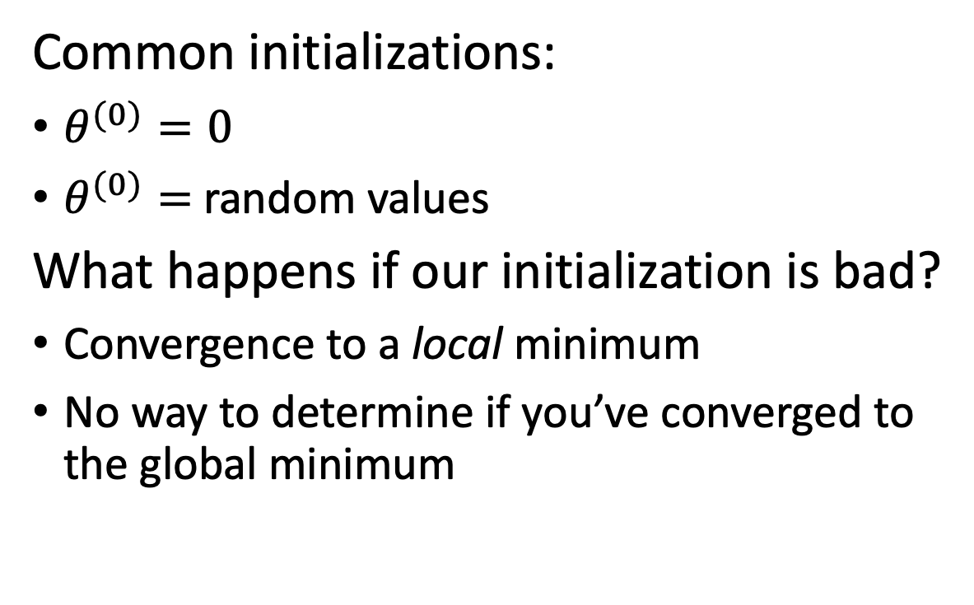
Parameter Initialization
Common initializations:
$θ^{(0)}=0$
$θ^{(0)}=$random values
What happens if our initialization is bad?
Convergence to a local minimum
No way to determine if you’ve converged to the global minimum
If we start here
We could end here
Notes:
Can try to take the lowest validation loss over k random inits

Slide 12
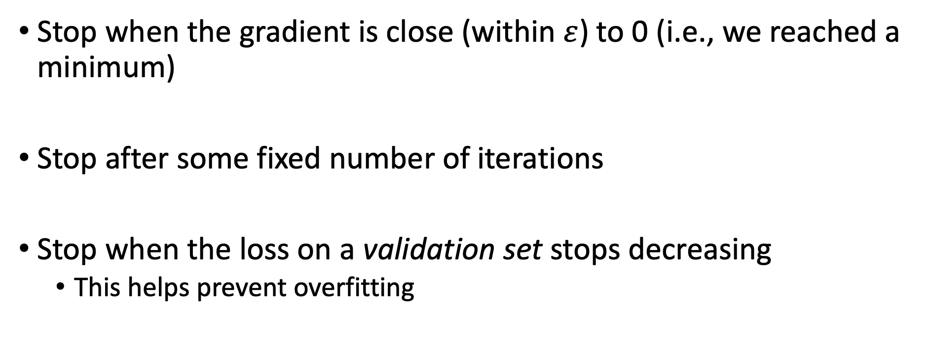
Knowing when to stop gradient descent
Stop when the gradient is close (within $ε$) to 0 (i.e., we reached a minimum)
Stop after some fixed number of iterations
Stop when the loss on a validation set stops decreasing
This helps prevent overfitting
Notes:
Can try to take the lowest validation loss over k random inits

Slide 13
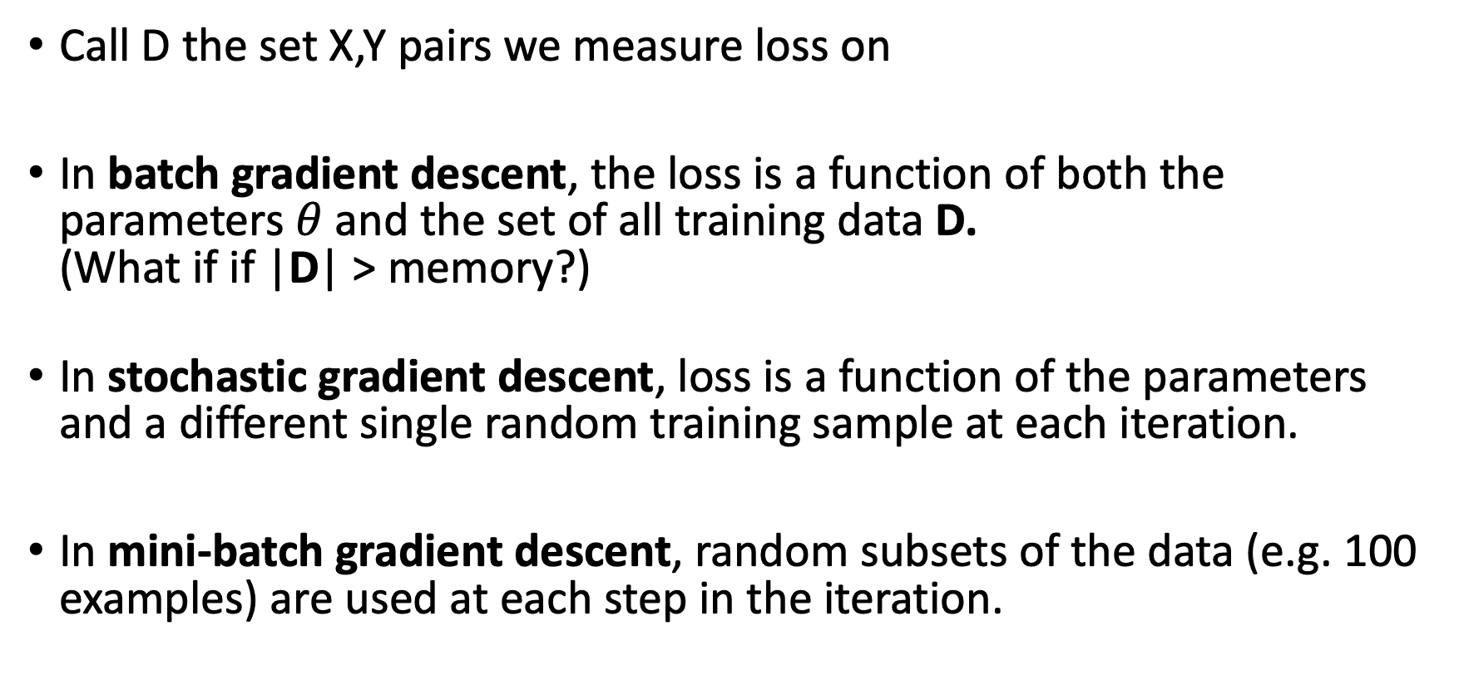
Stochastic, Batch, Mini-Batch Descent
Call D the set X,Y pairs we measure loss on
In batch gradient descent, the loss is a function of both the parameters $θ$and the set of all training data D. (What if if |D| > memory?)
In stochastic gradient descent, loss is a function of the parameters and a different single random training sample at each iteration.
In mini-batch gradient descent, random subsets of the data (e.g. 100 examples) are used at each step in the iteration.

Slide 14
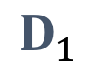
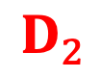
Different data, different loss
Call D the set X,Y pairs we measure loss on.
If D changes, then the landscape of the loss function changes
You typically won’t know how it has changed.
$$D_{1}$$
$$D_{2}$$
Loss L($X,Y;θ$)
$θ$: the value of some parameter

Slide 15
Loss functions

Slide 16
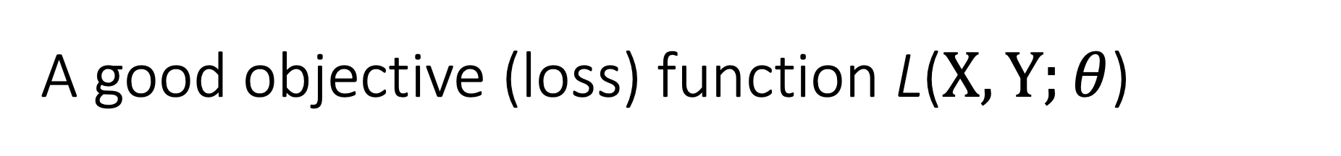
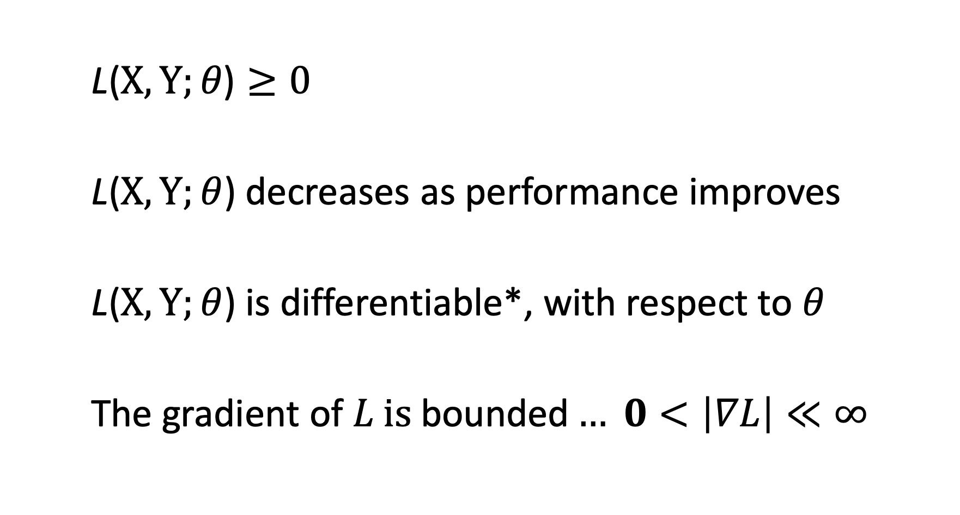
A good objective (loss) function L($X,Y;θ$)
$\text{L}\text{(}X,Y;θ\text{)}≥0$
L($X,Y;θ$) decreases as performance improves
L($X,Y;θ$) is differentiable*, with respect to $θ$
$\text{The} \text{gradient} \text{of} L \text{is} \text{bounded}… 0<\left|∇L\right|≪∞$
data
parameters
labels
Required
Required
for gradient
descent
helpful
For gradient
descent
*or subdifferentiable
Notes:
* Make it a point that infinite and you lose, but much less than infinite is really good

Slide 17
Example: 0 1 loss
SSE is same everywhere in the blue
Gradient 0 in the blue region!

Slide 18
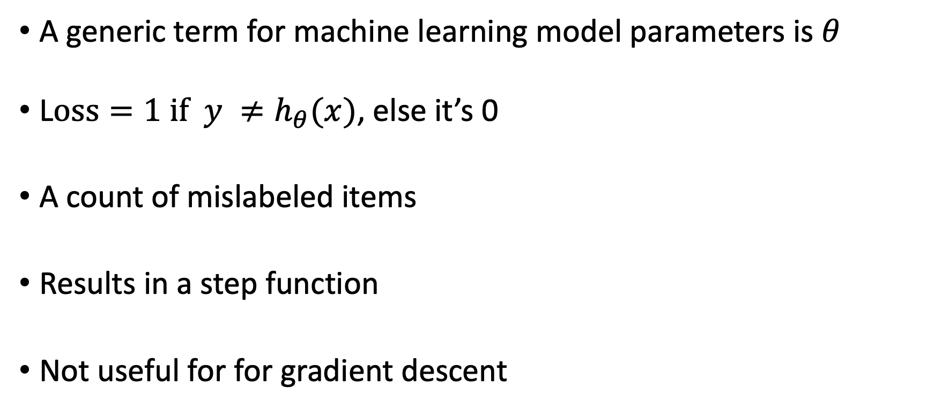
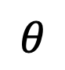
The 0 1 Loss function
A generic term for machine learning model parameters is $θ$
L$oss=1 if y ≠h_{θ}(x)$, else it’s 0
A count of mislabeled items
Results in a step function
Not useful for for gradient descent
$$θ$$
Notes:
Outlier behavior and canonical example behavior for squared loss are very different

Slide 19

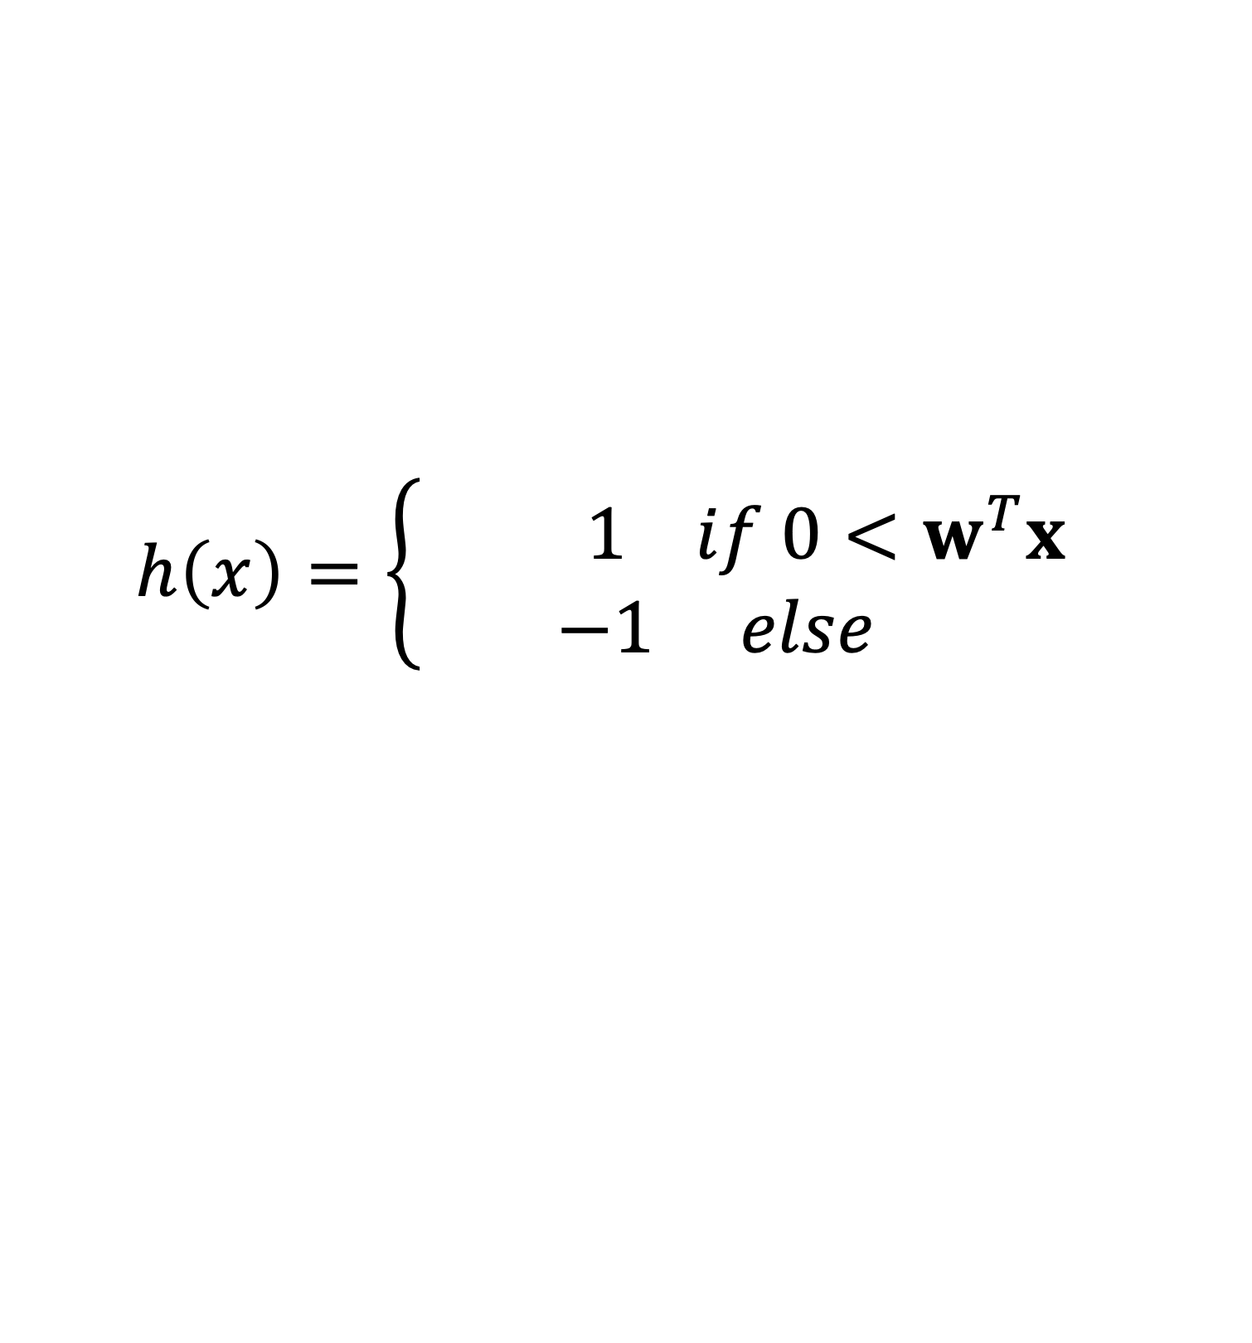

Perceptron Problem: The step function
$$h\left(x\right)$$
$$w^{T}x$$
$$h\left(x\right)=\left\{ \begin{matrix}1 if 0<w^{T}x \\ −1 else \end{matrix}\right.$$

Slide 20


Solution: Remove the step function
$$h\left(x\right)$$
$$w^{T}x$$
$$h\left(x\right)=w^{T}x$$

Slide 21
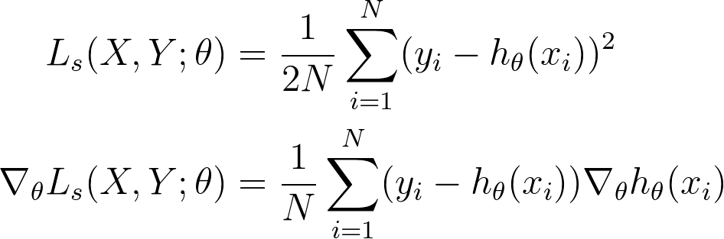
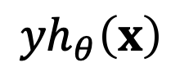
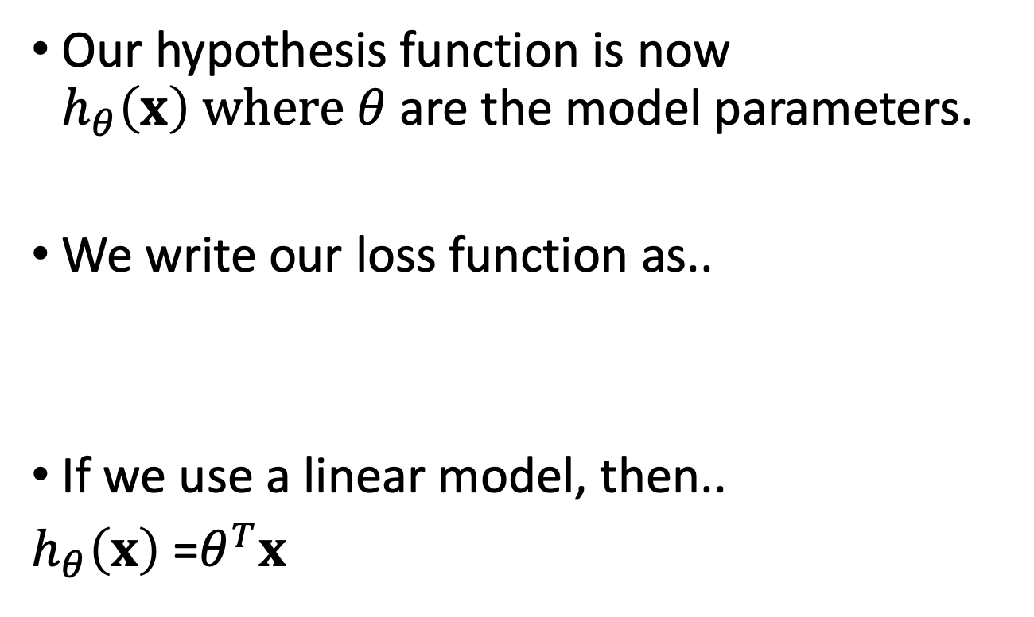
Squared loss: we now have a gradient
Our hypothesis function is now $h_{θ}\left(x\right) where θ$are the model parameters.
We write our loss function as..
If we use a linear model, then..
$h_{θ}\left(x\right)$ =$θ^{T}x$
$${yh}_{θ}\left(x\right)$$
Notes:
Outlier behavior and canonical example behavior for squared loss are very different

Slide 22


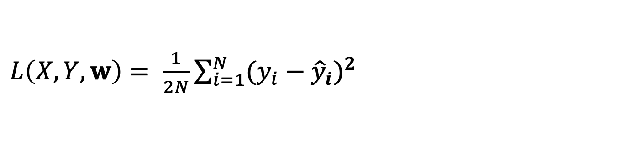
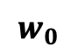

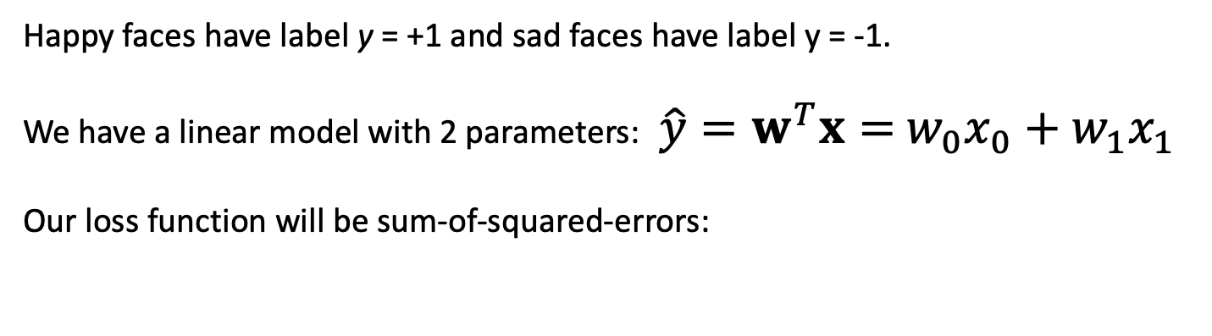
A simple example: where do you draw the line?
Happy faces have label y = +1 and sad faces have label y = -1.
We have a linear model with 2 parameters: $\hat{y}=w^{T}x=$ $w_{0}x_{0}+w_{1}x_{1}$
Our loss function will be sum-of-squared-errors:
$L\left(X,Y,w\right)=$ $\frac{1}{2N}\sum_{i=1}^{N}{{(y_{i}−{\hat{y}}_{i})}^{2}}$
0
$$w_{0}$$
How does the loss change as we move the line defined by $w_{0}$ ?
Can we use that to decide where to move it?
What does $w_{1}$ do?

Slide 23
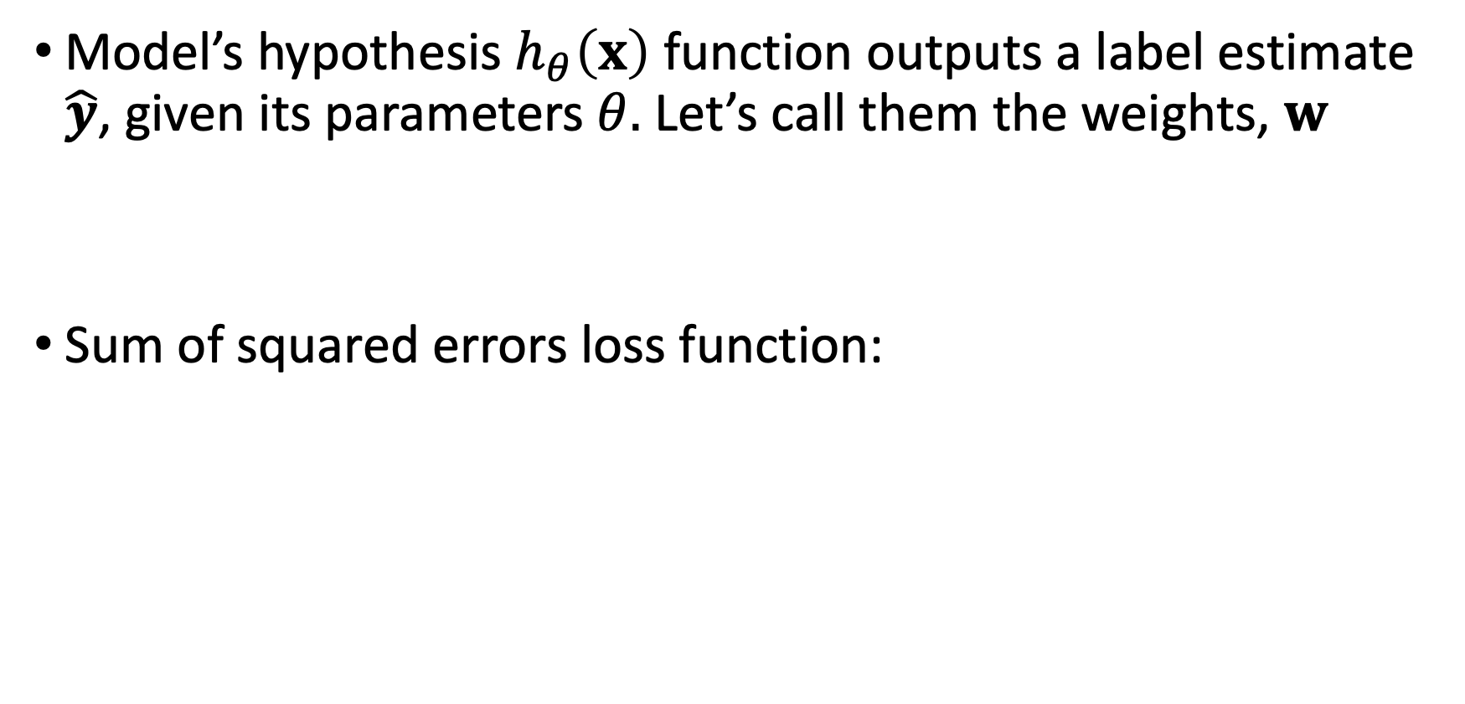
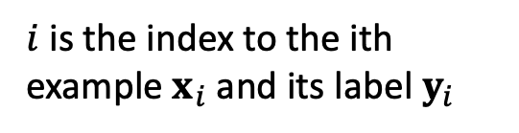
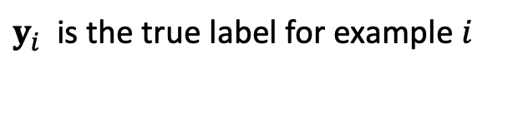
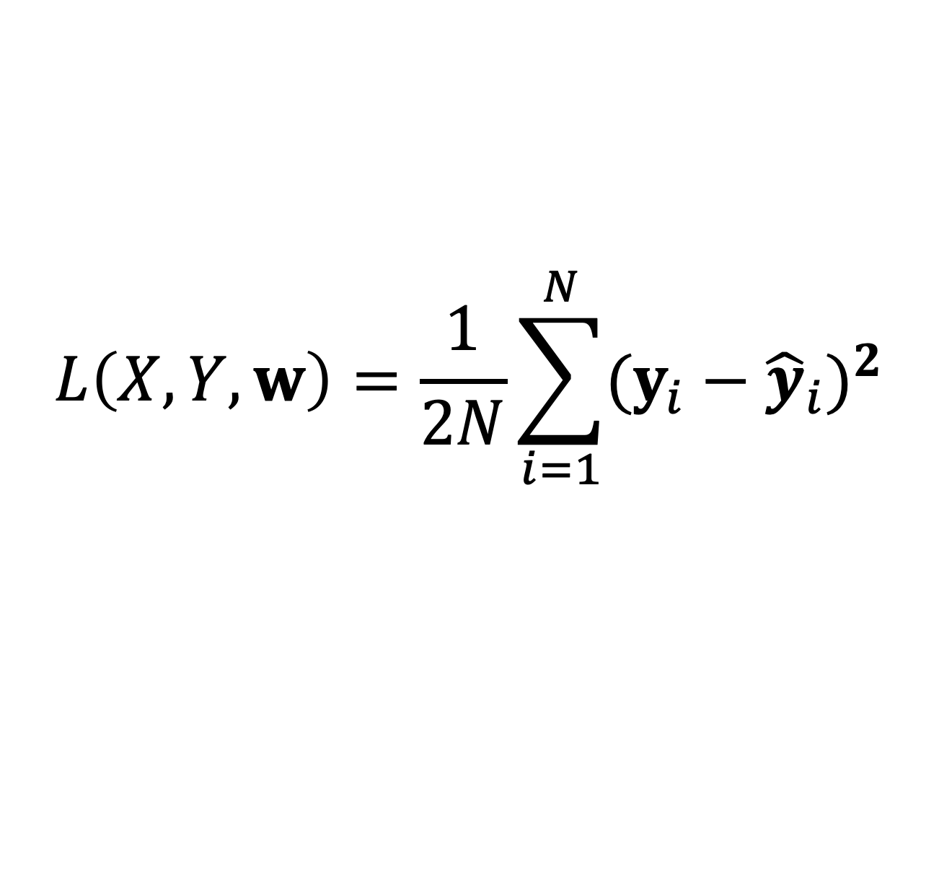
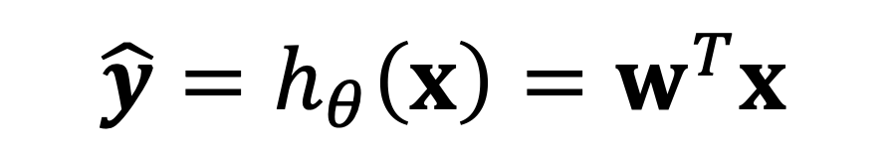
Measuring loss for a linear unit
Model’s hypothesis $h_{θ}\left(x\right)$ function outputs a label estimate $\hat{y}$, given its parameters $θ.$ Let’s call them the weights, $w$
Sum of squared errors loss function:
$$\hat{y}=h_{θ}\left(x\right)=w^{T}x$$
$y_{i}$ is the true label for example $i$
$$L\left(X,Y,w\right)=\frac{1}{2N}\sum_{i=1}^{N}{{(y_{i}−{\hat{y}}_{i})}^{2}}$$
This ½ makes the derivative simpler
$i$ is the index to the ith example $x_{i}$ and its label $y_{i}$
N is a normalizing factor so different batch sizes have comparable loss. Safe to remove.

Slide 24
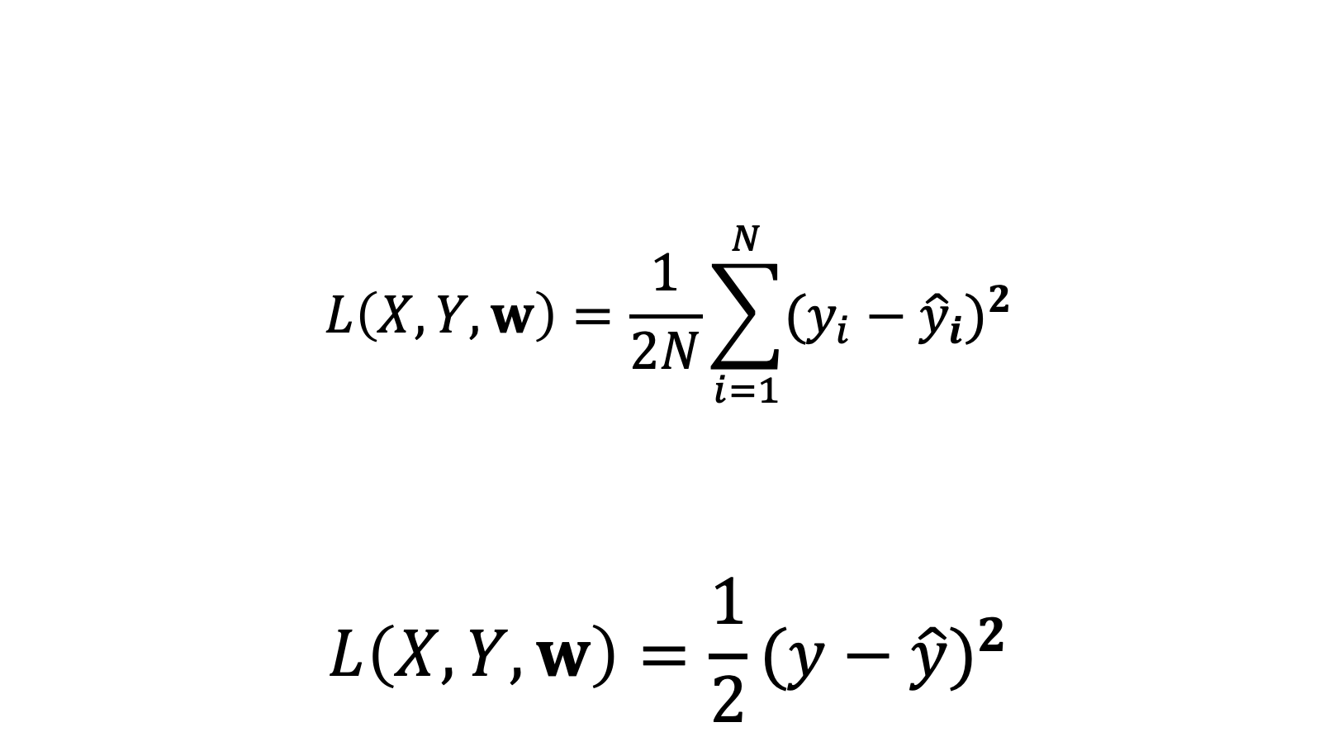
If we consider a single example, then…
$$L\left(X,Y,w\right)=\frac{1}{2N}\sum_{i=1}^{N}{{(y_{i}−{\hat{y}}_{i})}^{2}}$$
$$L\left(X,Y,w\right)=\frac{1}{2}{(y−\hat{y})}^{2}$$
Setting the number of data points N = 1 results in…

Slide 25
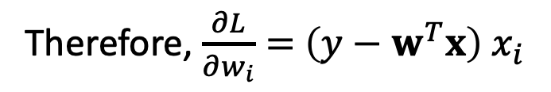
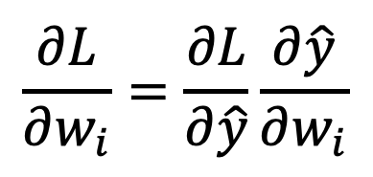

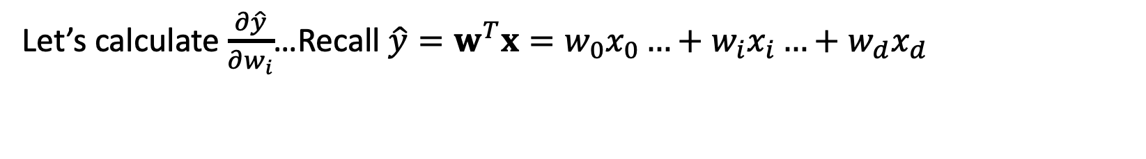
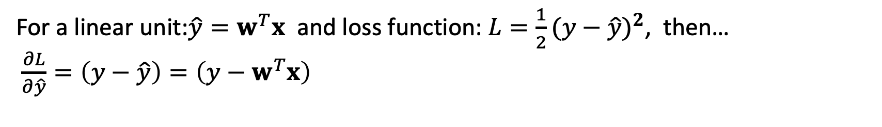
For each dimension i, take the partial derivative
$$\frac{∂L}{∂w_{i}}=\frac{∂L}{∂\hat{y}}\frac{∂\hat{y}}{∂w_{i}}$$
gives the change of our loss function $L$ with respect to weight $w_{i}$
For a linear unit:${\hat{y}=w}^{T}x$ and loss function: $L=\frac{1}{2}{(y−\hat{y})}^{2}$, then…
$\frac{∂L}{∂\hat{y}}=\left(y−\hat{y}\right)=\left(y−w^{T}x\right)$
Let’s calculate $\frac{∂\hat{y}}{∂w_{i}}$…Recall ${\hat{y}=w}^{T}x=w_{0}x_{0}…+w_{i}x_{i}…+w_{d}x_{d}$
$w_{i} i$s the only variable weight in this partial derivative, therefore: $\frac{∂\hat{y}}{∂w_{i}}=$ $x_{i}$
Therefore, $\frac{∂L}{∂w_{i}}=$ $\left(y−w^{T}x\right)$ $x_{i}$

Slide 26
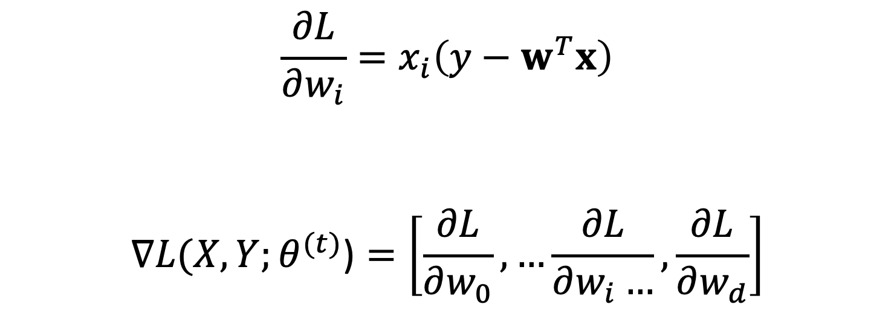
We now have each weight’s portion of the gradient for a linear model.
$$\frac{∂L}{∂w_{i}}=x_{i}\left(y−w^{T}x\right)$$
$$∇L(X,Y;θ^{(t)}\text{)}=\left[\frac{∂L}{∂w_{0}},…\frac{∂L}{∂w_{i}…},\frac{∂L}{∂w_{d}}\right]$$

Slide 27
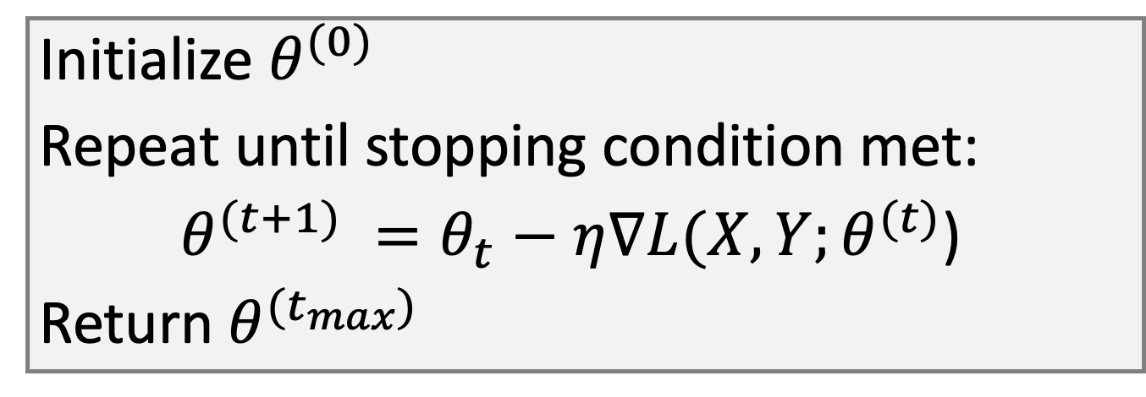
The gradient can now be used here
Initialize $θ^{(0)}$
Repeat until stopping condition met:
$θ^{(t+1)} =θ_{t}−η∇L(X,Y;θ^{(t)}$)
Return $θ^{(t_{max})}$
$θ^{(t)}$ are the parameters of the model at time step t
$∇L(X,Y;θ^{(t)}$) is the gradient of the loss function with respect to model parameters $θ^{(t)}$
$η$ controls the step size
$θ^{(t_{max})}$ is the set of parameters that did best on the loss function.
Notes:
Remind students of the similarity with adaptive epsilon updates in reinforcement learning

Slide 28
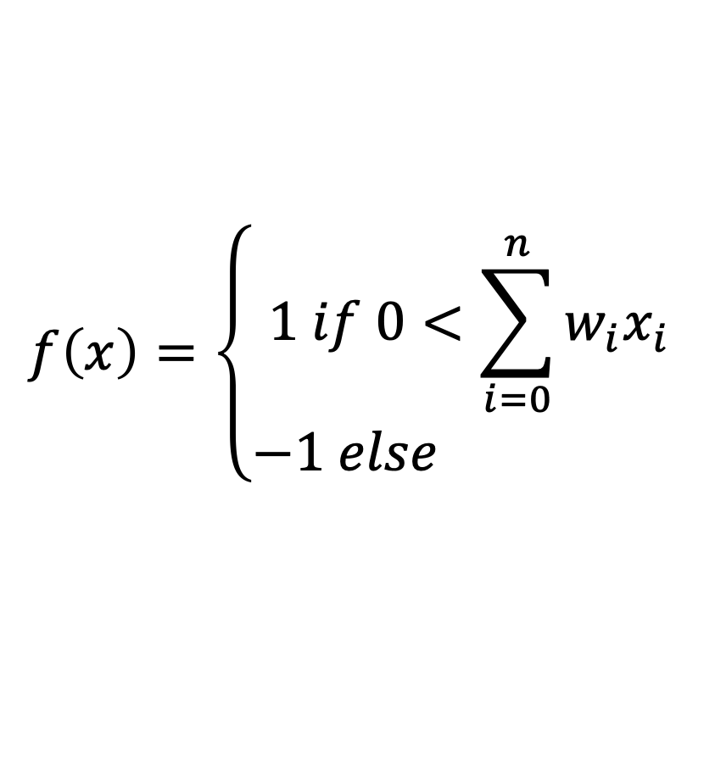
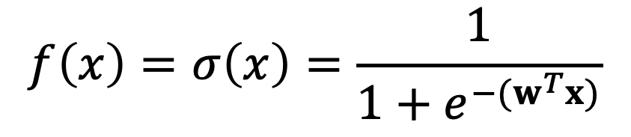
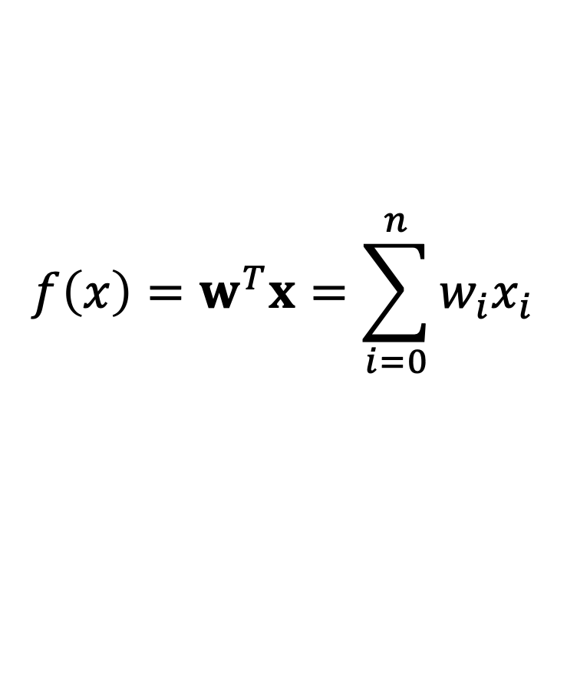
Sigmoid (aka Logistic) function: best of both
$$f\left(x\right)=\left\{\begin{matrix}1 if 0<\sum_{i=0}^{n}{w_{i}x_{i}} \\ −1 else \end{matrix}\right.$$
Perceptron
Linear
Sigmoid
$$f\left(x\right)=w^{T}x=\sum_{i=0}^{n}{w_{i}x_{i}}$$
$$f\left(x\right)=σ\left(x\right)=\frac{1}{1+e^{−(w^{T}x)}}$$

Slide 29
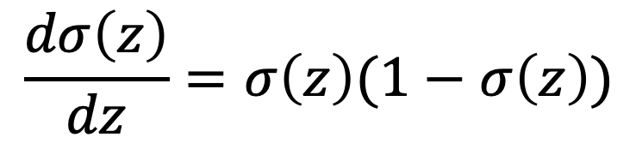
What’s cool about the sigmoid function
It looks like a rounded step function, so we can build circuits of arbitrary functions like we can with perceptrons
It has non-zero slope everywhere and no sharp corners
The derivative of the function is this:
…and it’s easy to plug into the gradient descent algorithm to get the learning rule.
$$\frac{dσ\left(z\right)}{dz}=σ\left(z\right)(1−σ\left(z\right))$$

Slide 30
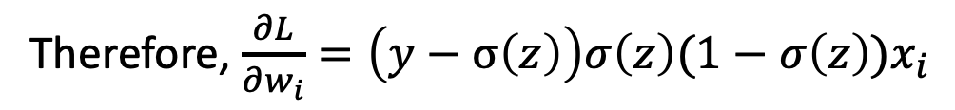
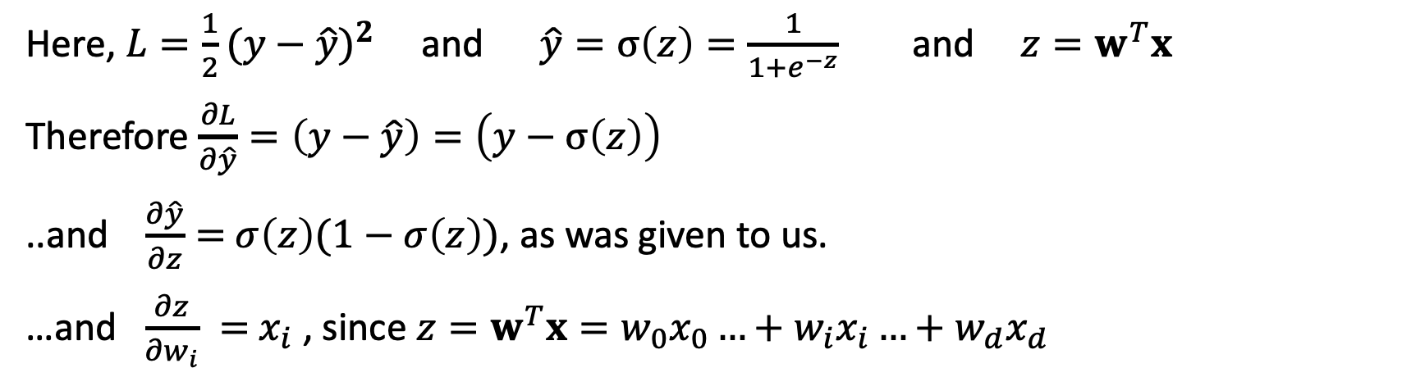
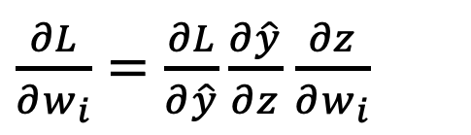
For each dimension i, take the partial derivative
$\frac{∂L}{∂w_{i}}=\frac{∂L}{∂\hat{y}}\frac{∂\hat{y}}{∂z}$ $\frac{∂z}{∂w_{i}}$
gives the change of our loss function $L$ with respect to weight $w_{i}$
Here, $L=\frac{1}{2}{(y−\hat{y})}^{2}$ and $\hat{y}=σ\left(z\right)=\frac{1}{1+e^{−z}}$ and ${z=w}^{T}x$
Therefore $\frac{∂L}{∂\hat{y}}=\left(y−\hat{y}\right)=\left(y−σ\left(z\right)\right)$
..and $\frac{∂\hat{y}}{∂z}=$ $σ\left(z\right)(1−σ\left(z\right))$, as was given to us.
…and $\frac{∂z}{∂w_{i}} =$ $x_{i}$ , since ${z=w}^{T}x=w_{0}x_{0}…+w_{i}x_{i}…+w_{d}x_{d}$
Therefore, $\frac{∂L}{∂w_{i}}=\left(y−σ\left(z\right)\right){σ\left(z\right)(1−σ\left(z\right))x}_{i}$

Slide 31

For each dimension i, take the partial derivative
From the previous slide: $\frac{∂L}{∂w_{i}}=\left(y−σ\left(z\right)\right){σ\left(z\right)(1−σ\left(z\right))x}_{i}$
L${et}^{′}s compose σ\left(z\right)=\frac{1}{1+e^{−z}}$ and ${z=w}^{T}x$ into one function (called $σ\left(x\right)$), to get the following:
$σ\left(x\right)=\frac{1}{1+e^{−w^{T}x}}$
This lets us now write the change in loss as:
$\frac{∂L}{∂w_{i}}=\left(y−σ\left(x\right)\right){σ\left(x\right)(1−σ\left(x\right))x}_{i}$

Slide 32
Backpropagation of error

Slide 33

Where we left off
We have the $σ(x)$ sigmoid function that we can train with gradient descent, because it’s differentiable and has a non-zero gradient everywhere.
We can plug multiple sigmoids together to form arbitrary Boolean functions, by just interpreting the last output with sign($σ(x))$
We now need a way to have error from the output sigmoid function to flow to the input, so we can adjust the parameters of every $σ(x)$ on the path from the input to the output when we do our gradient descent.

Slide 34

Consider one output node
Let’s define a function…
$δ=\left(y−σ\left(x\right)\right)$ $σ\left(x\right)(1−σ\left(x\right))$
Now this…
$\frac{∂L}{∂w_{i}}=\left(y−σ\left(x\right)\right){σ\left(x\right)(1−σ\left(x\right))x}_{i}$
…becomes this: $\frac{∂L}{∂w_{i}}={δx}_{i}$
For any output node $k$ we just use this, as before.
Output
Units
Weight
Matrix
Hidden
Units
Weight
Matrix
Input
Units

Slide 35

Consider one hidden node
For a hidden node $h$we need to redefine $δ$. Instead of comparing the output of the node to a known target output $y$, we look at its contribution to the output of the $k$ nodes it is connected to at the next layer.
$$δ=\left(\sum_{k}{w_{k}}δ_{k}\right)σ\left(x\right)(1−σ\left(x\right))$$
…and we then do: $\frac{∂L}{∂w_{i}}={δx}_{i}$
We can do this repeatedly for multiple
hidden layers.
Output
Units
Weight
Matrix
Hidden
Units
Weight
Matrix
Input
Units

Slide 36
Some stuff I should mention
Notes:
Rosenblatt, Frank. "The perceptron: A probabilistic model for information storage and organization in the brain." Psychological review 65.6 (1958): 386.

Slide 37
Sigmoid + SSE are not your only choices
Pick an activation function
Pick a loss function
Make sure they’re both differentiable (or sub-differentiable)
You can now do backpropagation of error

Slide 38


Rectified Linear Unit (ReLU) & Soft Plus :
ReLU
Soft Plus
Both can be combined in layers to make non-linear functions
$$f\left(x\right)=max⁡(0,w^{T}x)$$
$$f\left(x\right)=ln⁡(1+e^{w^{T}x})$$

Slide 39
“One Hot” Encoding
A vector of values where a single element is 1 and all the rest are 0
Common way to encode the true label, y, in a multi-class labeling problem
Can be interpreted as a probability distribution
y = 0 0 1 0 0 0 0 0 0 0
y = 0 0 0 0 0 1 0 0 0 0

Slide 40
Probability distribution

Slide 41

Soft Max Function
Turns an N-dimensional vector of real numbers into a probability distribution, even if the numbers are both pos
For a deep net, $a_{i}$ is the output of the ith node in the output layer
${ p}_{i}=\frac{e^{a_{i}}}{\sum_{j=1}^{N}{e^{a_{j}}}}$

Slide 42

Why softmax?
Why do I need this?${ p}_{i}=\frac{e^{a_{i}}}{\sum_{j=1}^{N}{e^{a_{j}}}}$
Wouldn’t taking the absolute value and averaging do just as well?
$${ p}_{i}=\frac{|a_{i}|}{\sum_{j=1}^{N}{|a_{j}|}}$$
Softmax is a multivariate extension of the sigmoid (logistic) function
When combined with cross entropy loss function, the resulting derivative is a very nice one.

Slide 43

Entropy
Entropy is the measure of the skewedness of a distribution
The higher the entropy, the harder it is to guess the value a random variable will take when we draw from the distribution.
Here,
$$H(P)=−\sum_{i=1}^{N}{ P(i)log⁡(P(i)})$$

Slide 44
Some examples

Slide 45

Cross Entropy
Cross entropy is a measure of the similarity between distributions
It is *NOT* symmetric.
$$H(P,Q)=−\sum_{i=1}^{N}{ P(i)log⁡(Q(i)})$$

Slide 46

An example
Distribution P
Distribution Q
$$H(P,Q)=−\sum_{i=1}^{N}{ P(i)log⁡(Q(i)})=1.39$$

Slide 47

An example
Distribution P
Distribution Q
$$H(P,Q)=−\sum_{i=1}^{N}{ P(i)log⁡(Q(i)})=∞$$

Slide 48

Cross Entropy Loss Function
Given: “true” distribution $y=\{y_{1}$,$y_{2},…y_{N}\}$ <-often a one-hot encoding
and estimated distribution $\hat{y}=\{{\hat{y}}_{1}$,${\hat{y}}_{2},…{\hat{y}}_{N}\}$ <-soft max over the last layer
Define cross entropy loss between 2 distributions as
$$L\left(y,\hat{y}\right)=−\sum_{i=1}^{N}{y_{i}log⁡({\hat{y}}_{i}})$$

Slide 49

A common approach…
Define labels with a one-hot vector encoding
Make the last layer have n nodes for an n-way classification problem
Apply soft max to the last layer
Use a cross-entropy loss function
The resulting derivative of the loss function is wonderfully simple:
$$\frac{∂L}{∂a_{i}}={\hat{y}}_{i}−y_{i}$$
L is the loss, i is the index to a node, a is the output of the last layer, ${\hat{y}}_{}$ is the softmax probability distribution over the output layer of the network and y is the one-hot-encoding label.

Slide 50
There are many activation & loss functions
As a system designer, you need to consider what activation function make sense for your problem
The right loss function makes the difference between a learnable problem and an unlearnable one
Different layers may have different activation functions
Multiple loss functions may be used when teaching the network

